Slide 1


Slide 2
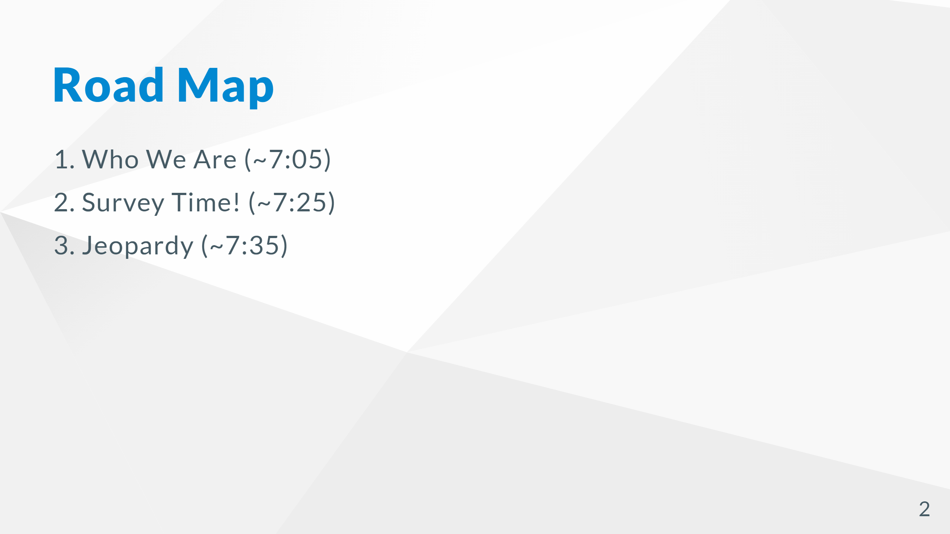

Slide 3
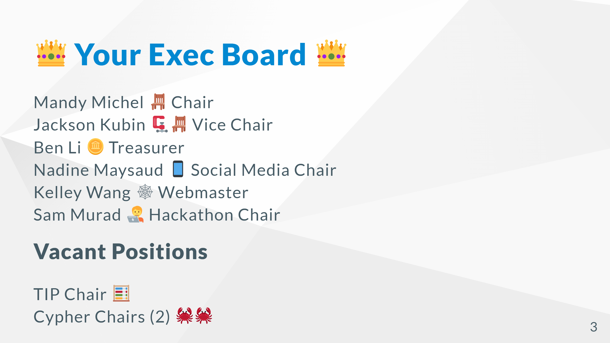

Slide 4
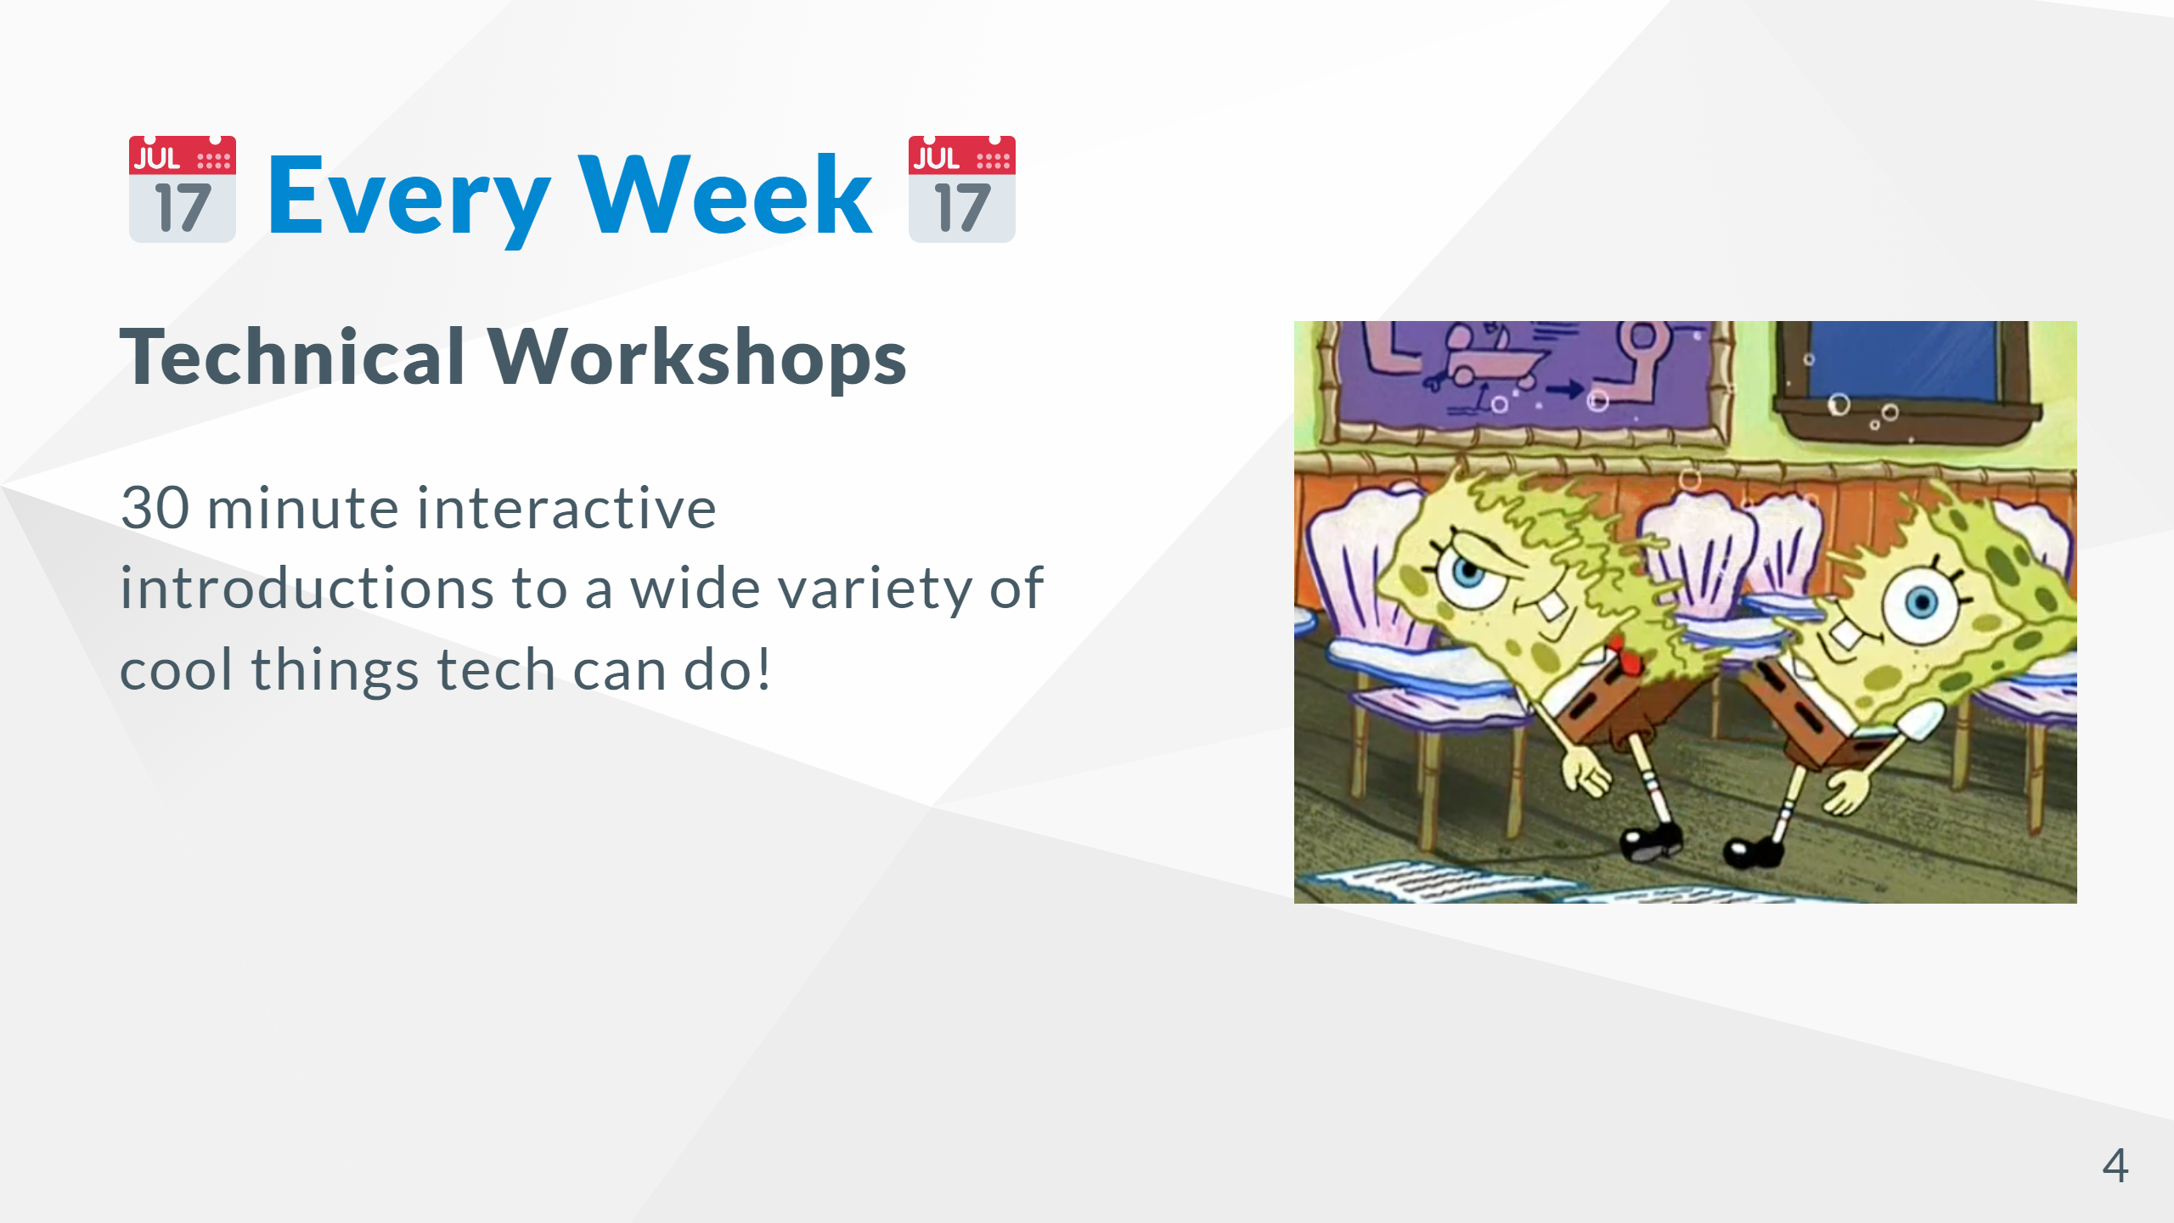

Slide 5
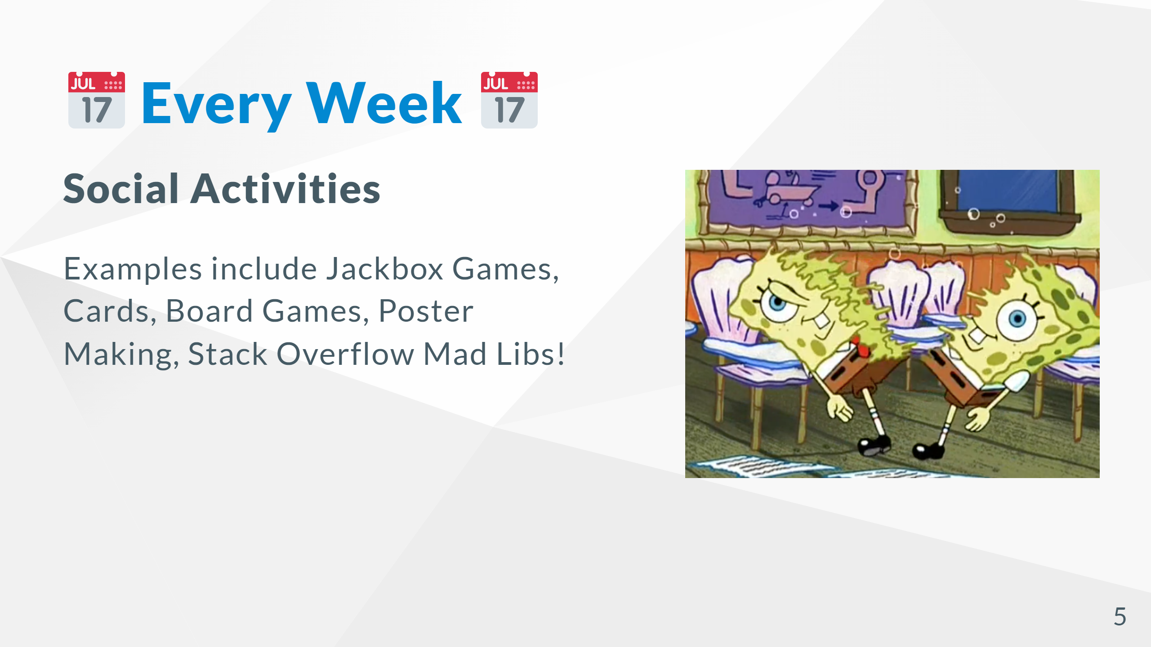

Slide 6
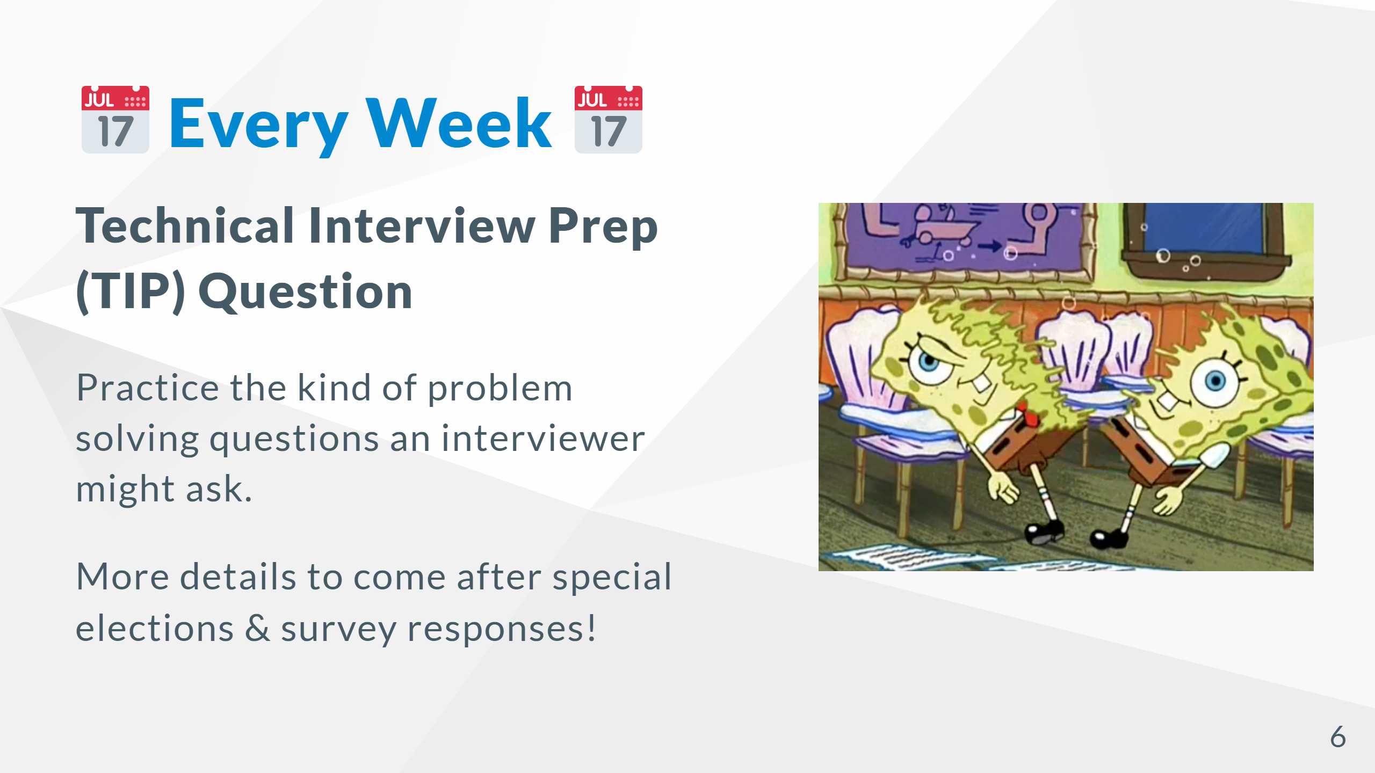

Slide 7


Slide 8


Slide 9
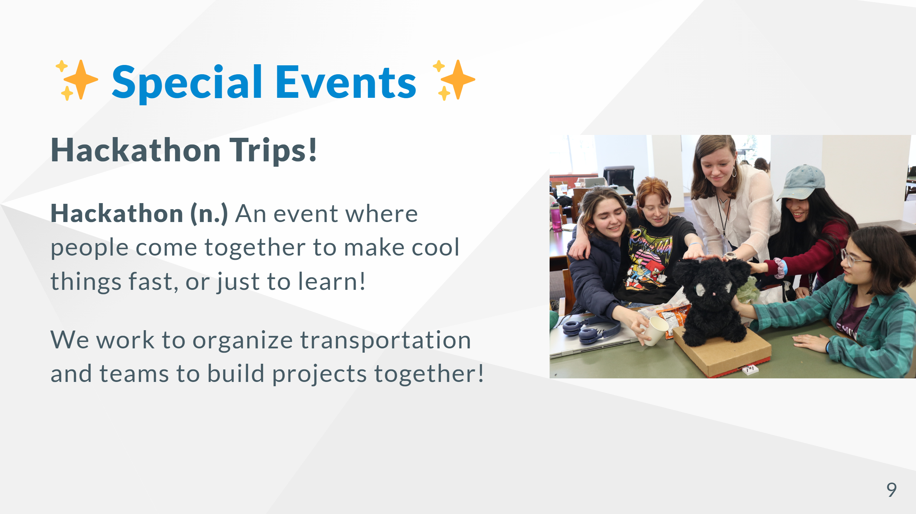

Slide 10
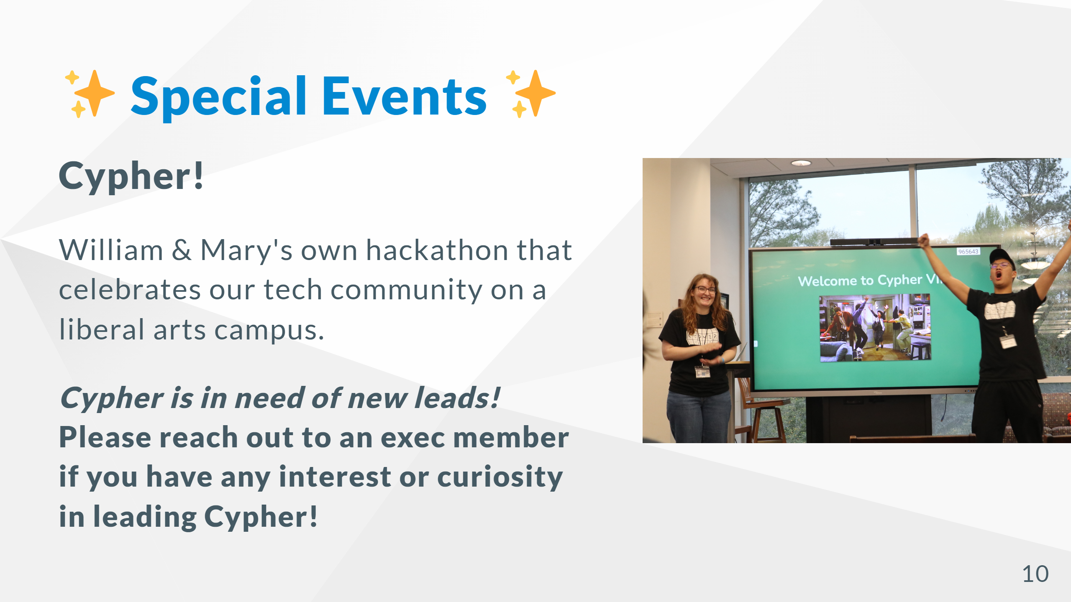

Slide 11
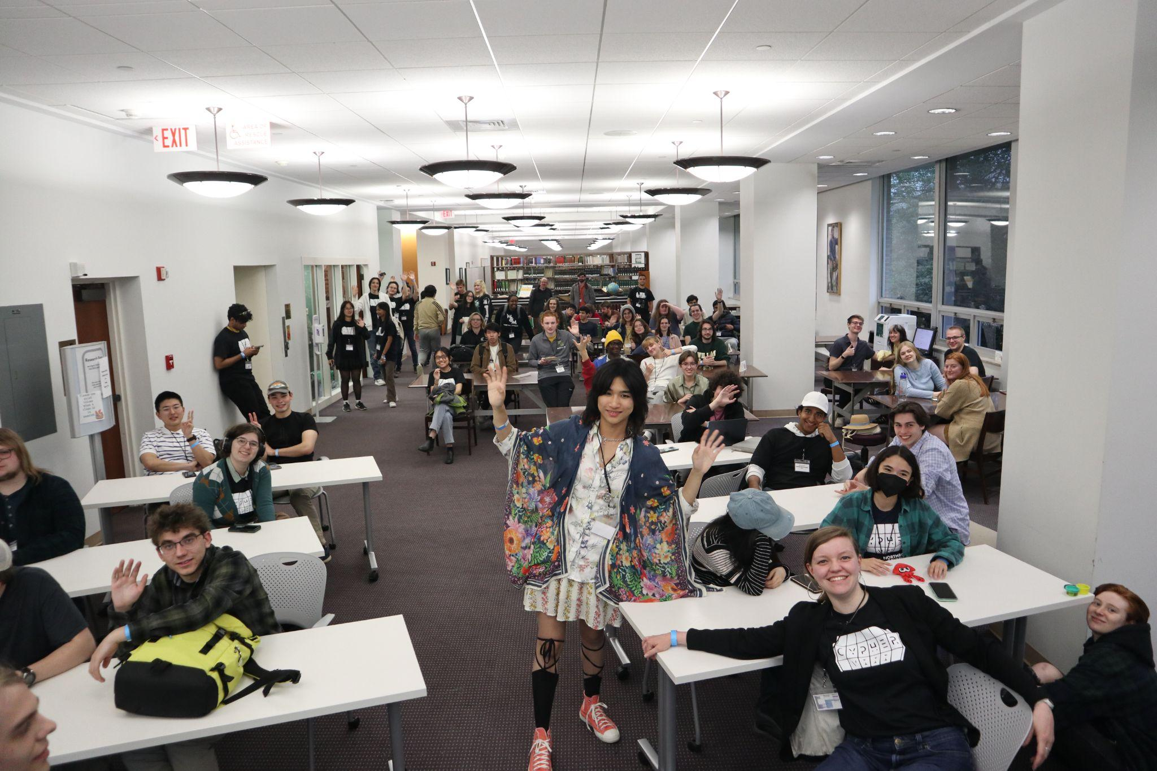

Slide 12
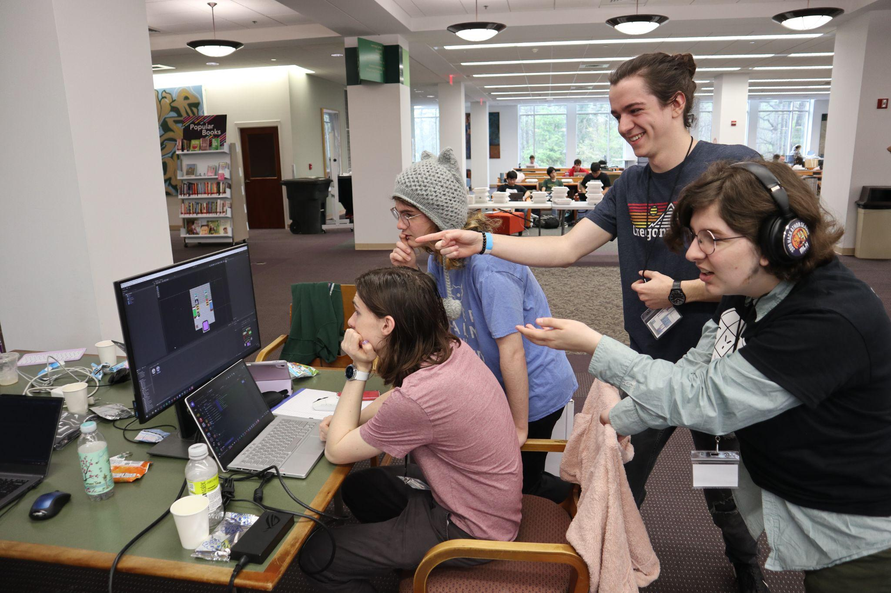

Slide 13
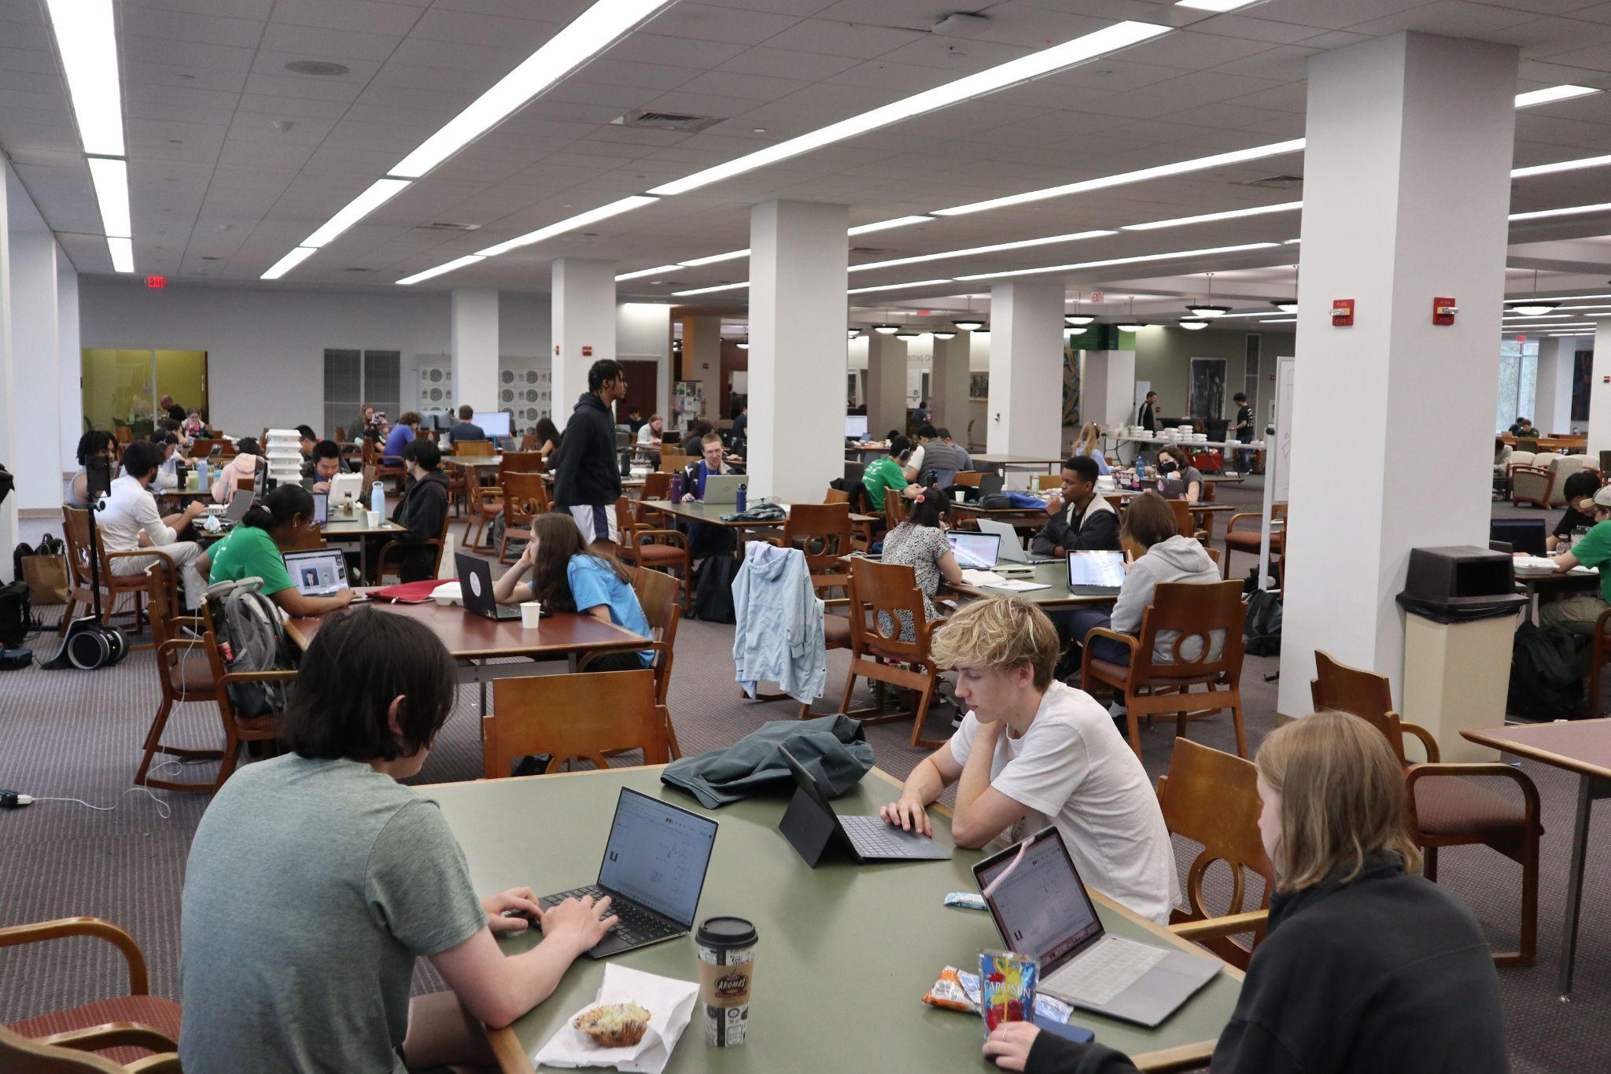

Slide 14
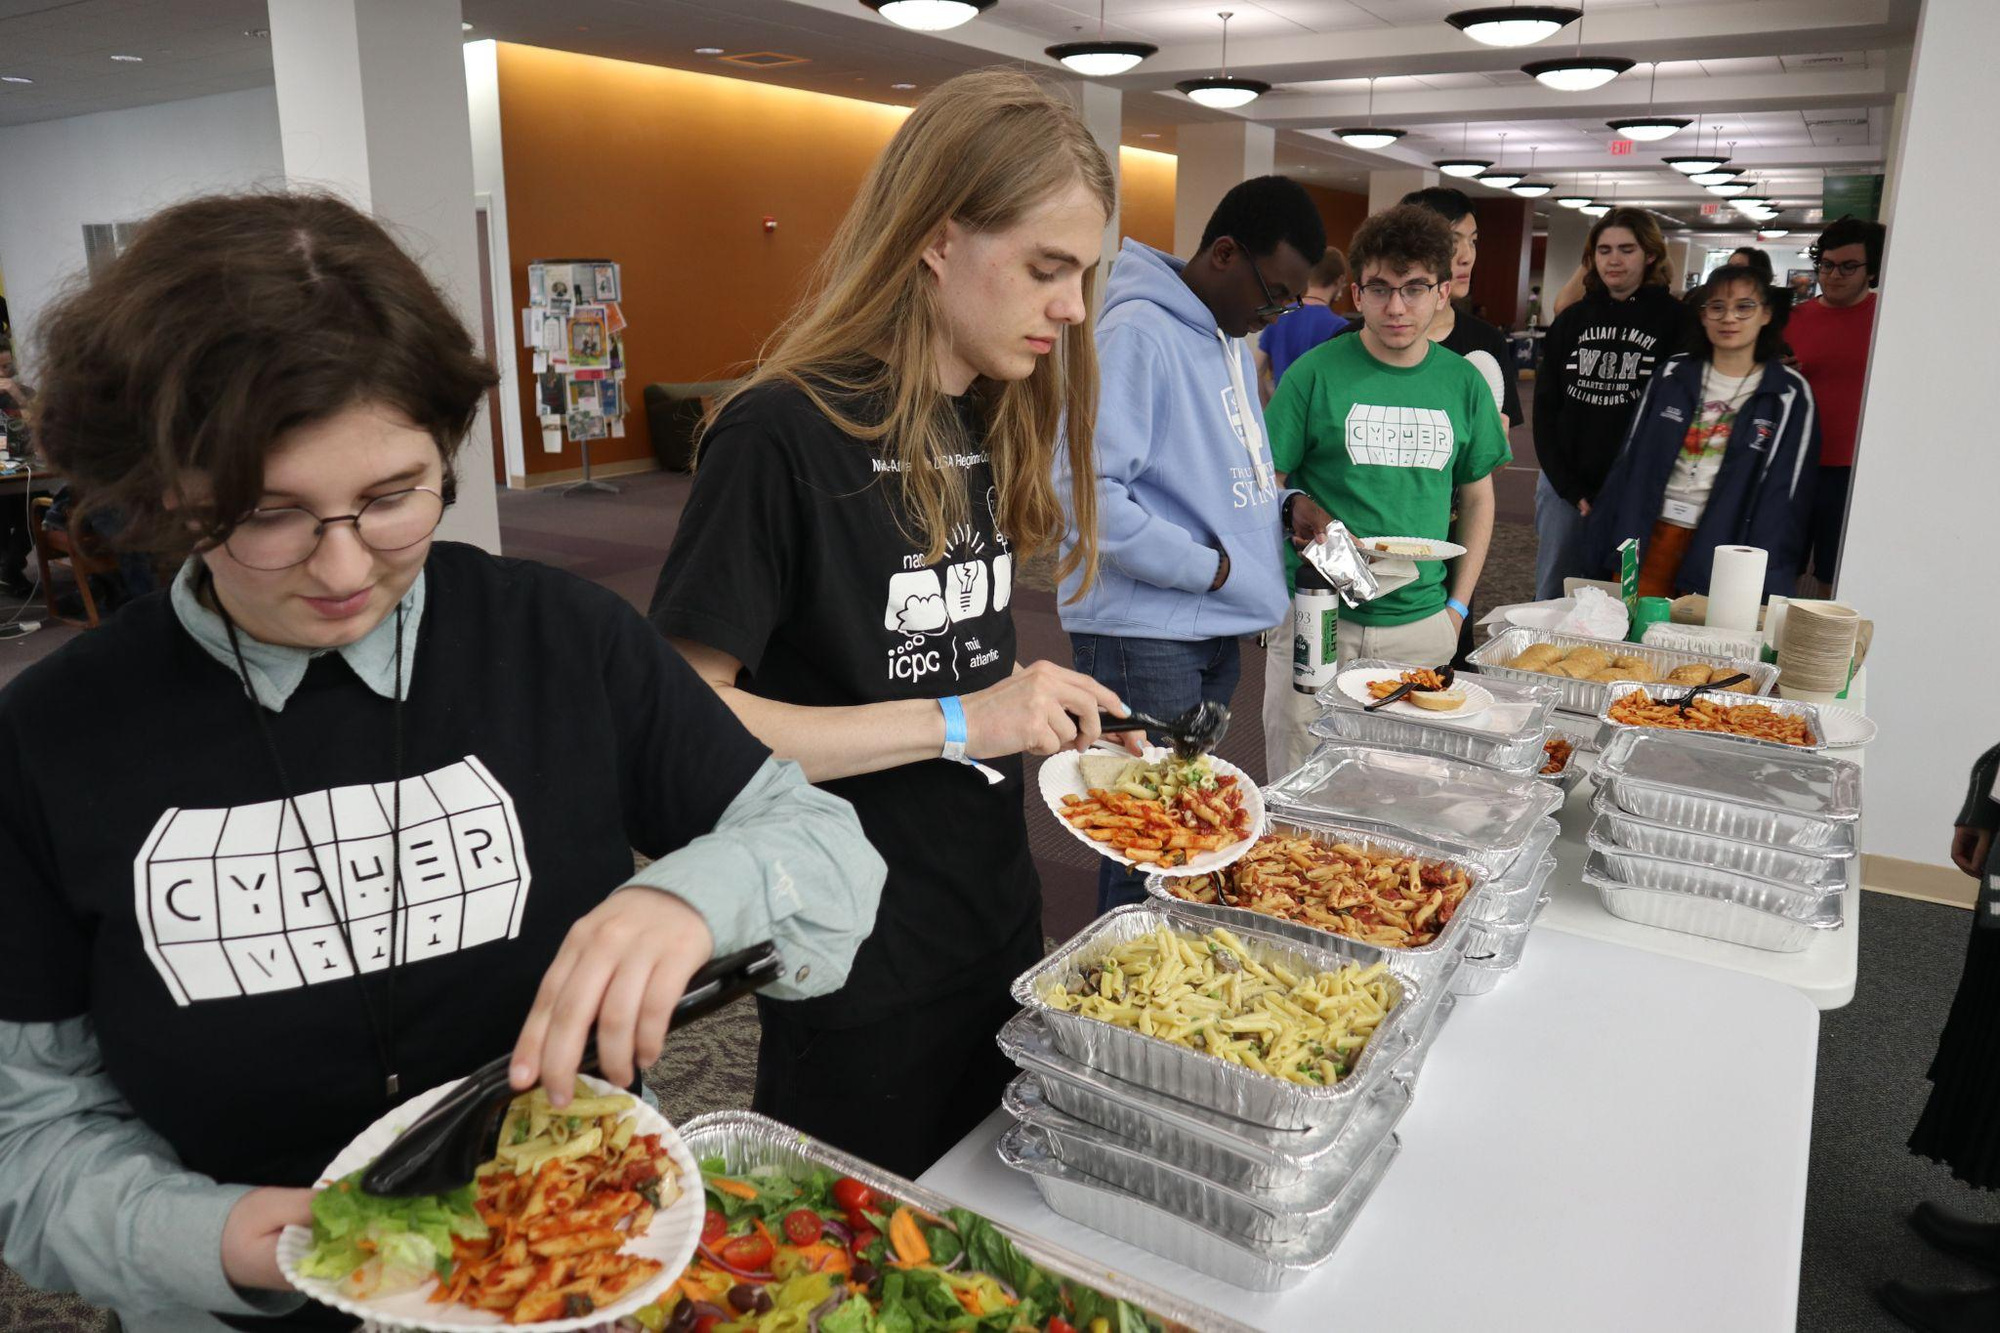

Slide 15
Cypher Organizing Team Responsibilities
- Chairs
- Distribute tasks, communicate to other exec members, make a timeline and make sure that others are sticking to it, act as a representative at meeting with CS department and Swem faculty, determine theme and judging categories, make sure event stick to our values and goals.
- Finance team
- Reach out to potential sponsors, create a sponsorship prospectus (includes potential sponsorship packages, relevant statistics, etc.), communicate with ACM treasurer, communicate with sponsors about their responsibilities during the event, determine prize budget.

Slide 16
Cypher Organizing Team Responsibilities
- Logistics
- Plan workshop and lectures. Reserved swem, study rooms, security. Order t-shirts, merchandise, monitor sponsor swag shipments. Decide on prizes given the budget from finance team, purchase and distribute prizes. Order food!
- Outreach
- Advertise event on instagram, through flyers, etc. Recruit mentors, judges, and student volunteers, create sign-up form.
- Technology
- Update website, create devpost, create and monitor discord. Communicate with IT.

Slide 17
Cypher Day-Of Volunteers
Day-of volunteers
- Pick up food, check hackers in, set-up, clean, answer questions, host workshops and talks.

Slide 18
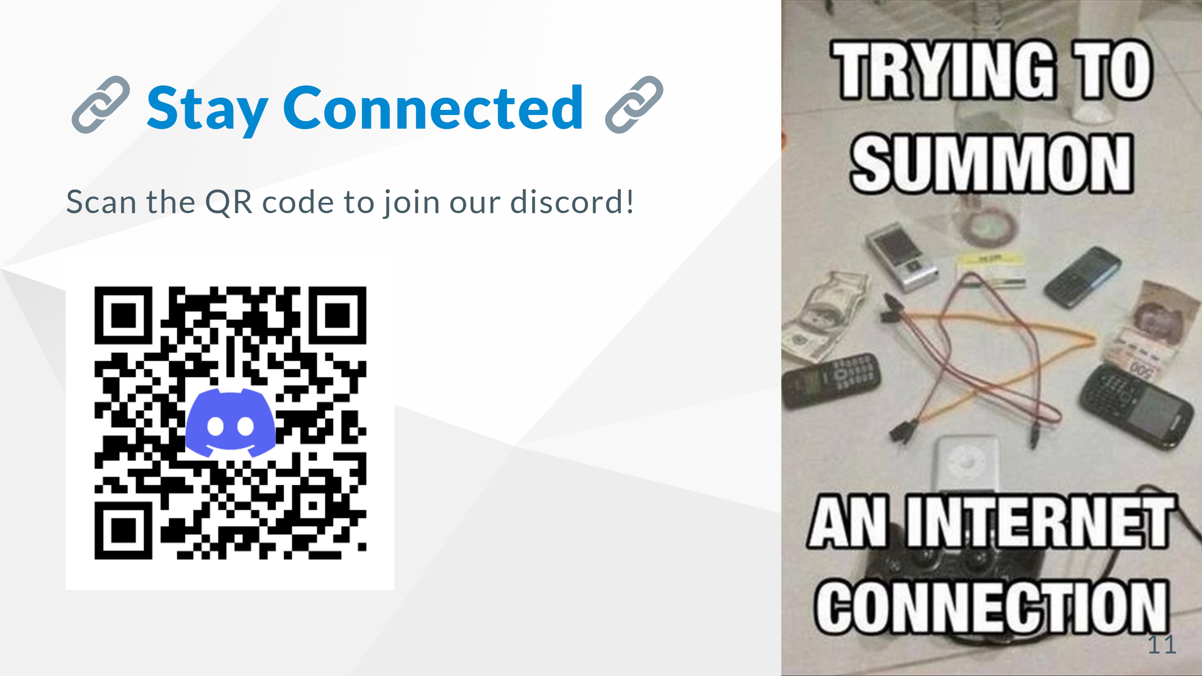

Slide 19
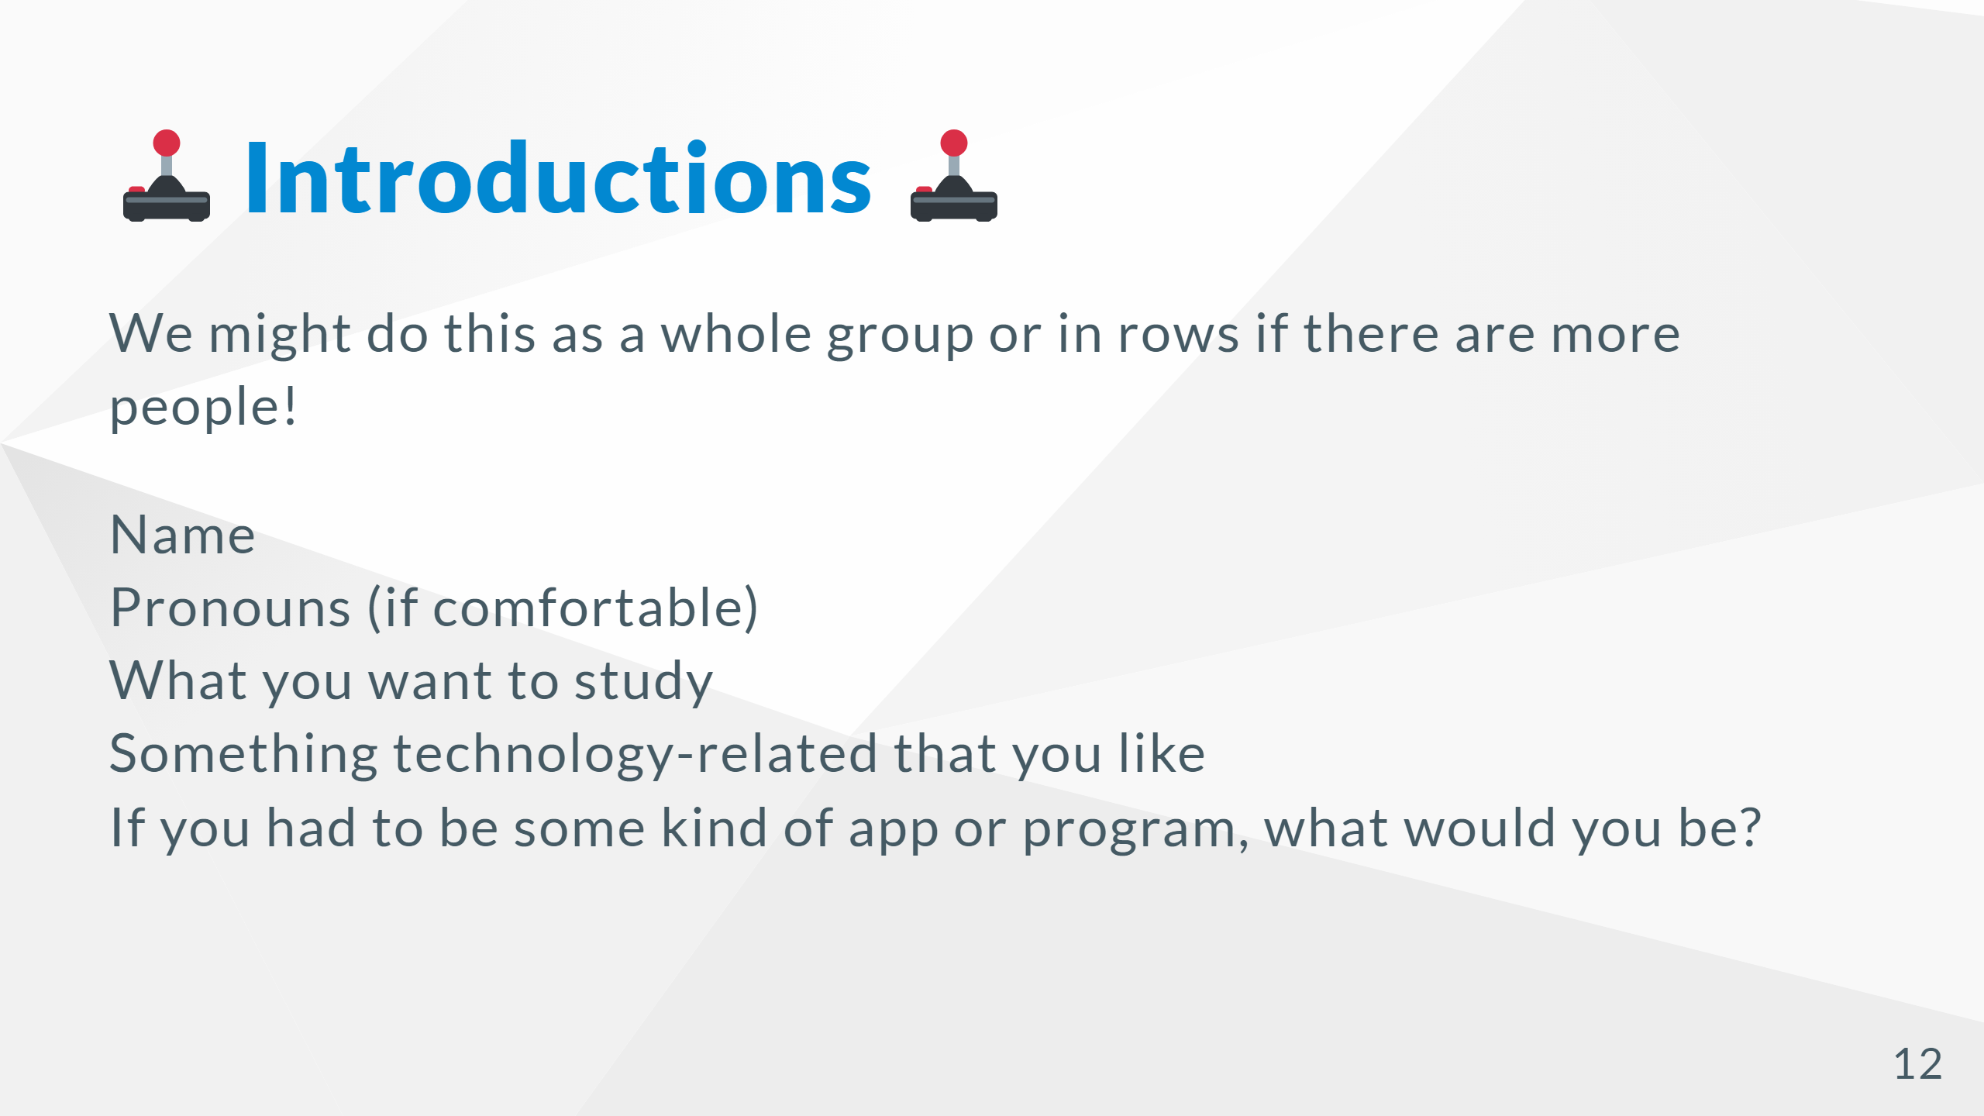

Slide 20


Slide 21
